Slide 1
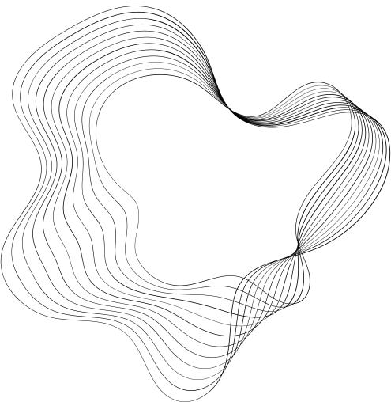

ALLYHUB
A Platform for Developers & Clients

Slide 2

Contents
01
List of Activities
02
Main and Sub Process
03
Context Level Diagram
04
Level – 0 Diagram
05
Level 1-n Diagrams
6/26/2024
A202
2

Slide 3





List of Activities
Clients
Developers
Signup & Login
Post & Edit Project Proposals
Browse, Search, filter out Developers
Sends Collaboration requests
Overview Applications by Developers
Make Payment
Exchange Feedbacks
Signup & Login
Browse and search Projects and Jobs
Apply for Projects and Jobs
Accept or Decline Collaboration Request
Receive Payments
Exchange Feedbacks
Explore other Developers for teaming up

Slide 4



Main Process and Sub Process
Process User Data
Signup
Login
Project Management
Post Project Proposal
Browse Projects
Filter Projects
Edit Project Proposal
Detailed View of Project Proposal

Slide 5

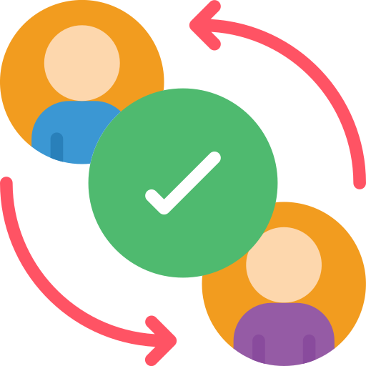
Main Process and Sub Process
Review Management
Get Reviews
Receive Reviews
Interaction Management
Send Collaboration Request
Accept or Decline Collaboration Request
Apply for Projects
Accept or Decline Applications
Make Payments
Get Receipt

Slide 6

Main Process and Sub Process
Exploration Management
Browse Developers
Browse Projects
Filter Developers and Projects

Slide 7

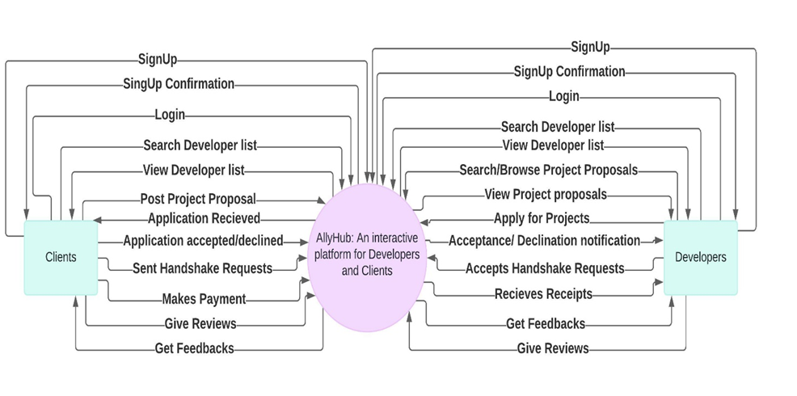

Context Level Diagram
CUSTOMERS

Slide 8
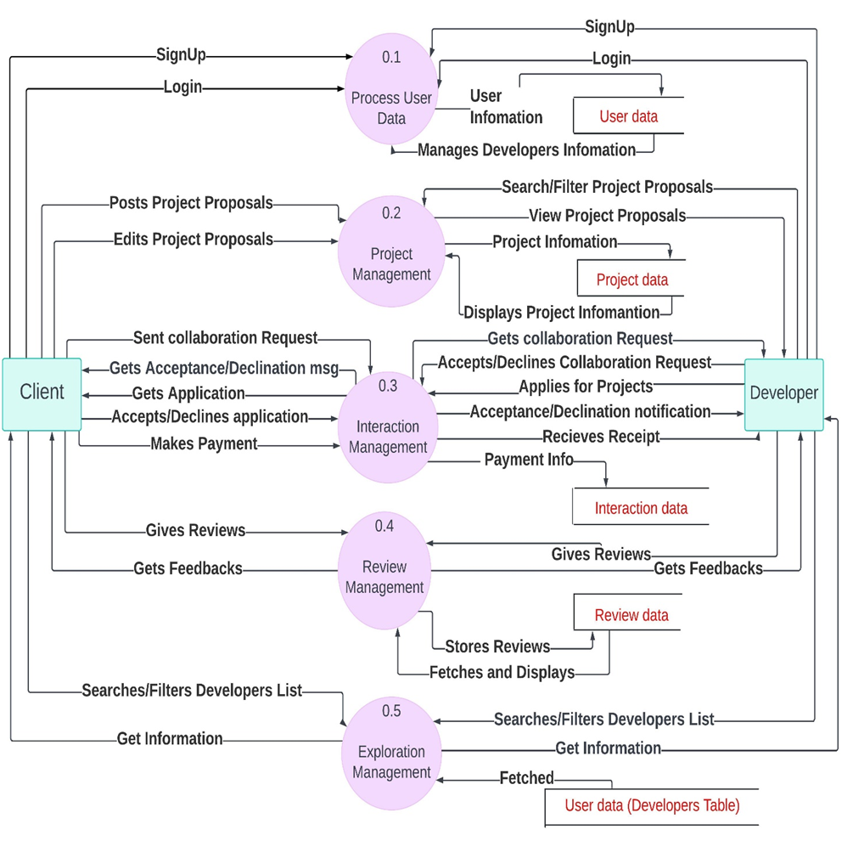
Level -0 Diagram
CUSTOMERS

Slide 9
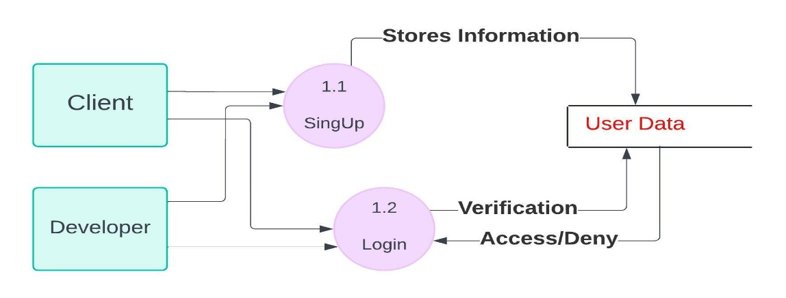
Level 1-n Diagrams
Process User Data
CUSTOMERS

Slide 10
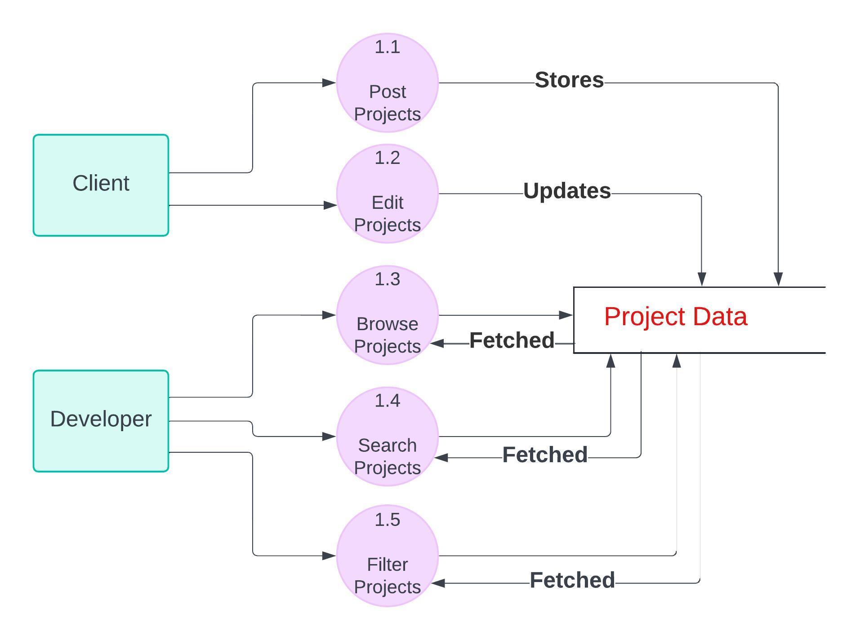
Level 1-n Diagrams
Project management
CUSTOMERS

Slide 11
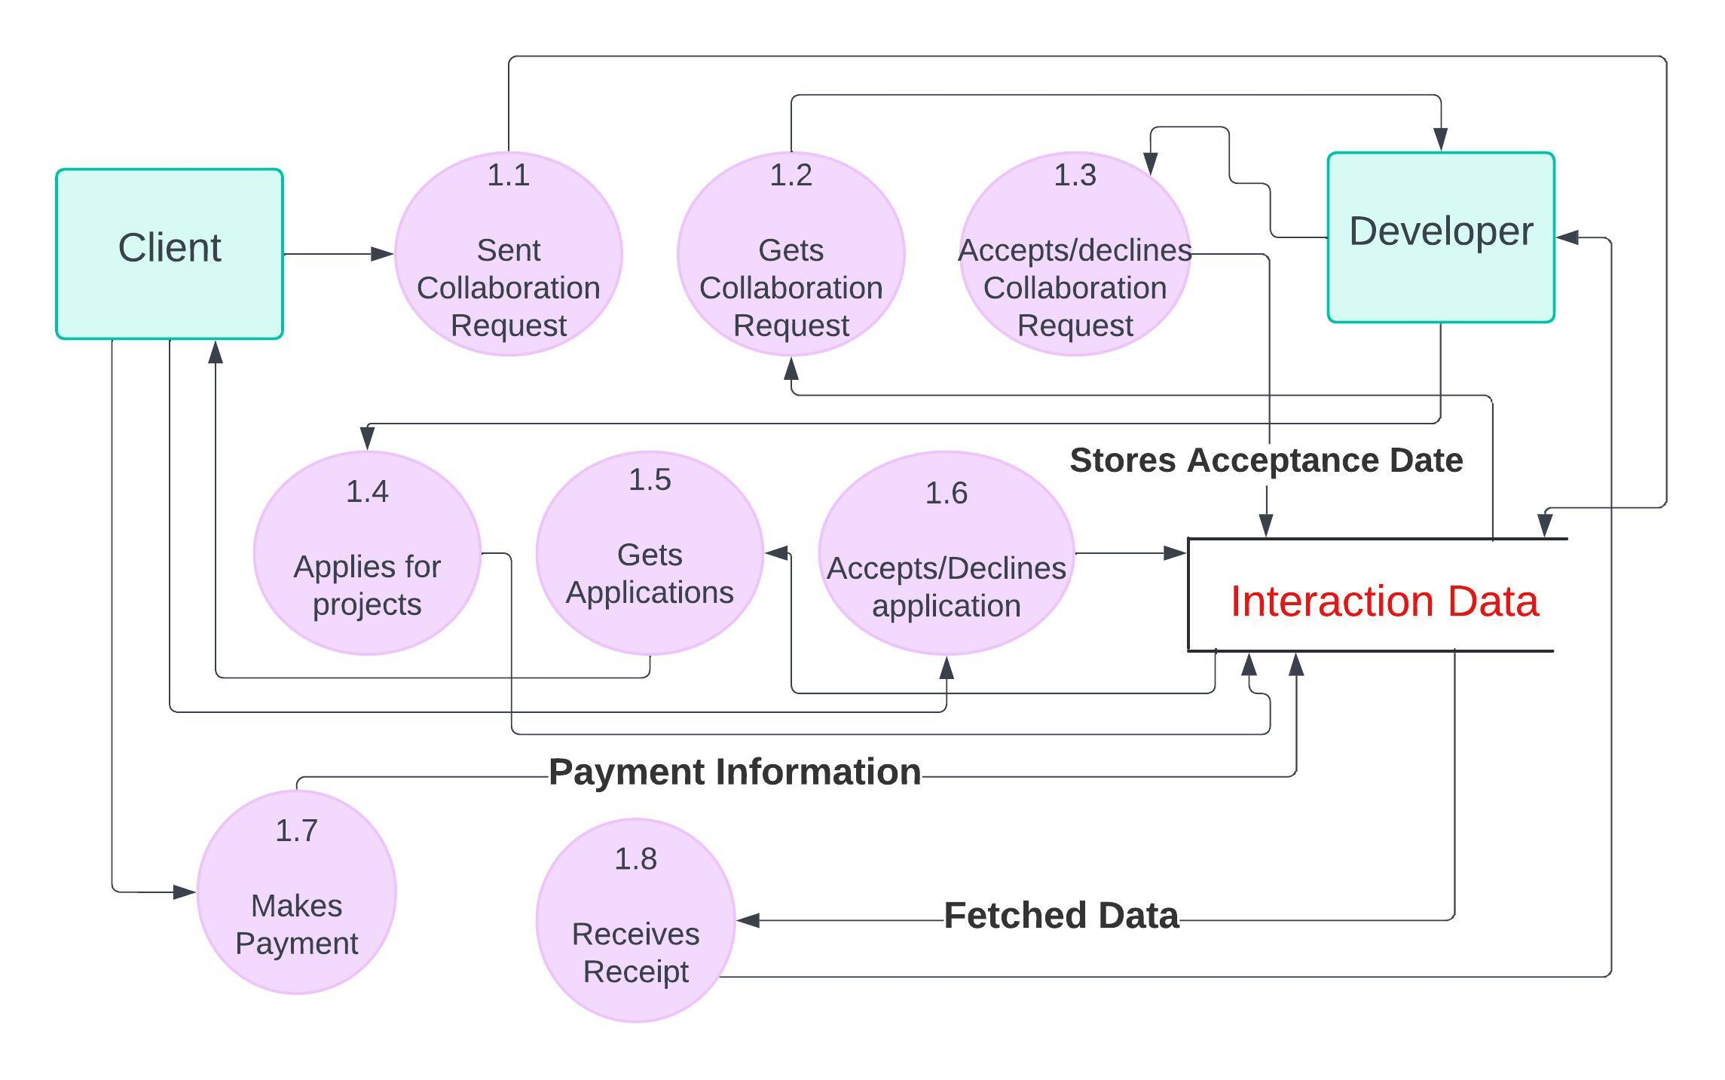
Level 1-n Diagrams
Interaction management
CUSTOMERS

Slide 12
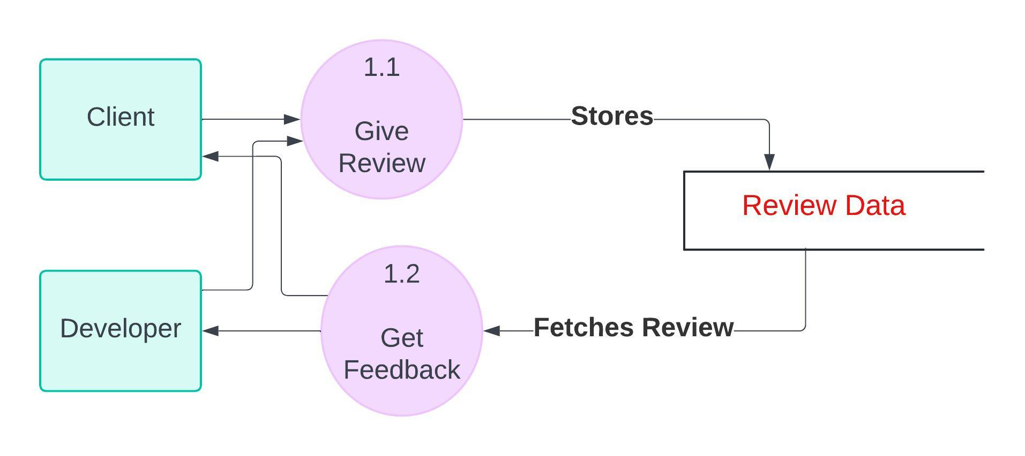
Level 1-n Diagrams
Review management
CUSTOMERS

Slide 13
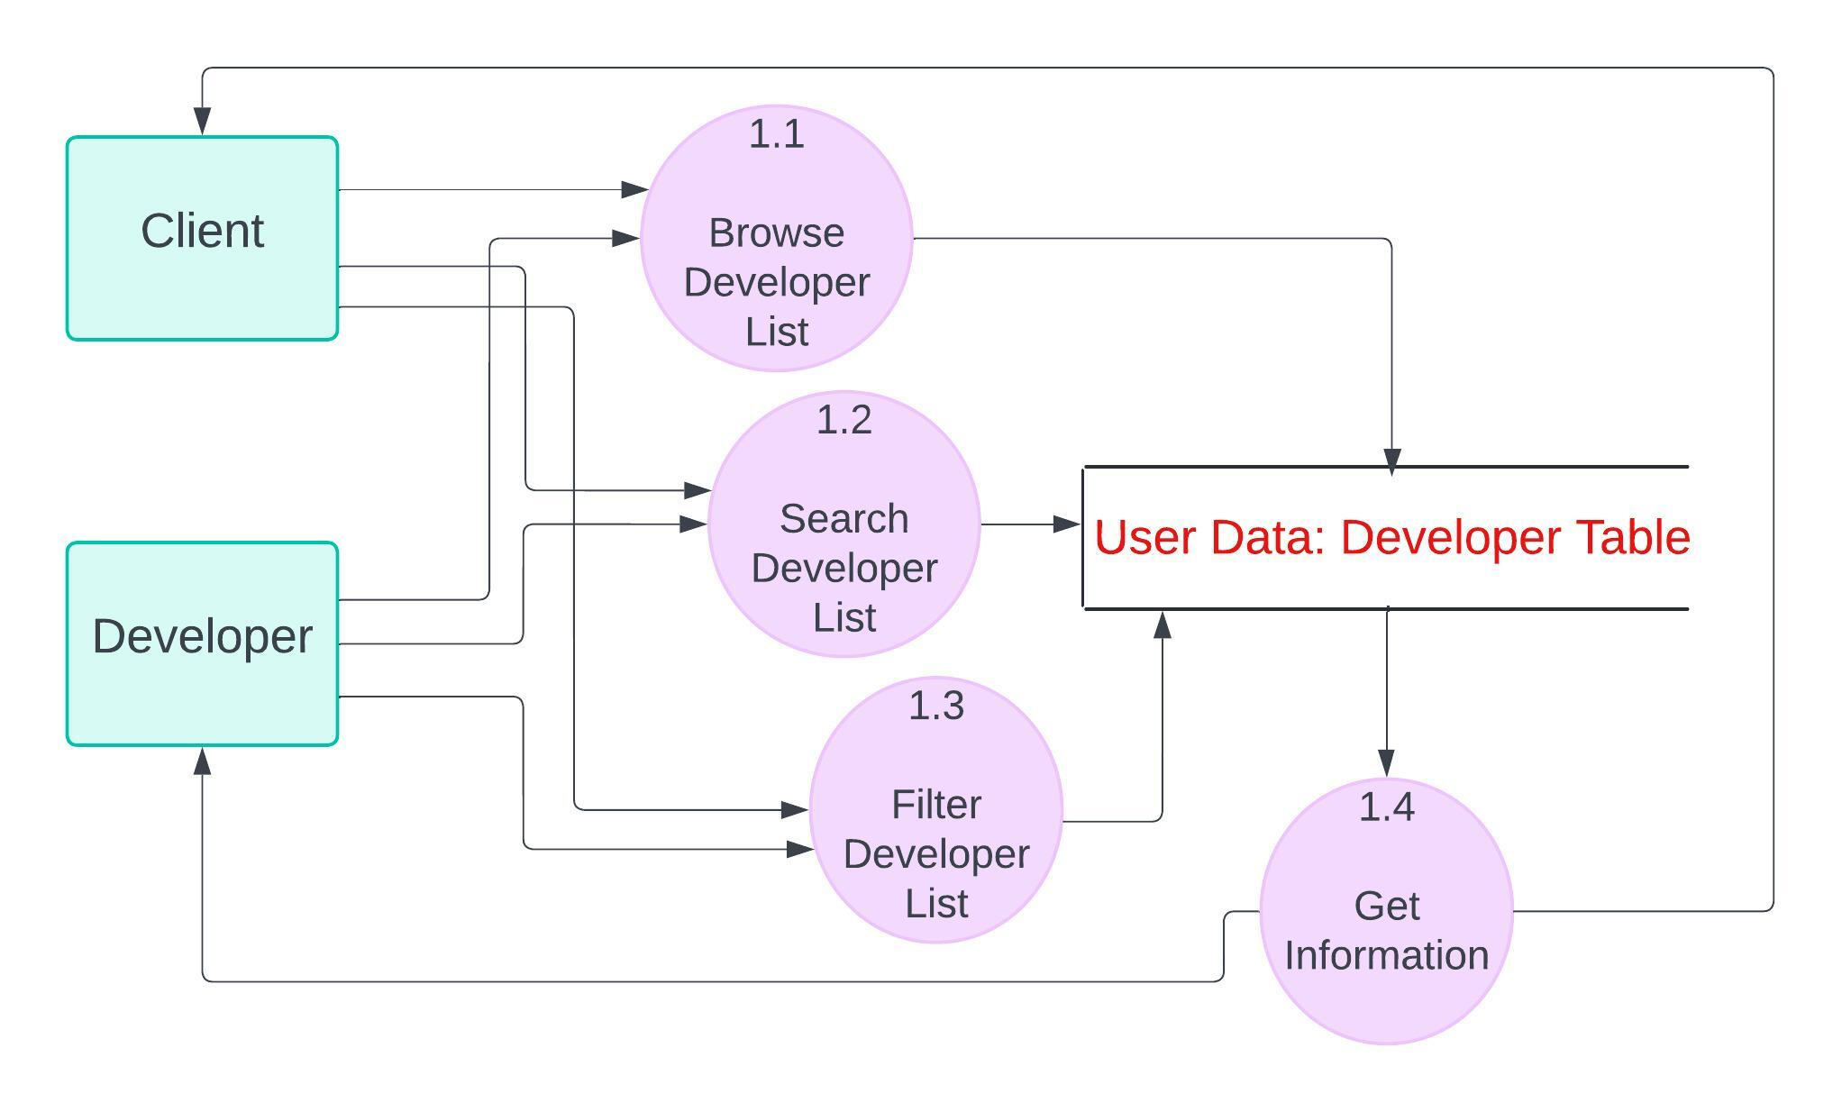
Level 1-n Diagrams
Exploration Management
CUSTOMERS

Slide 14

THANK YOU
Any Queries?

